Slide 1



(Almost) Everything You Need to Know About Password Managers
#GHC15
Jennie Kam
June 10, 2016
Originally given Oct 14, 2015 in Houston, TX
2015

Slide 2
Hello World
Who am I?

Slide 3
Hello World
Who am I?
Security Researcher for Cisco

Slide 4
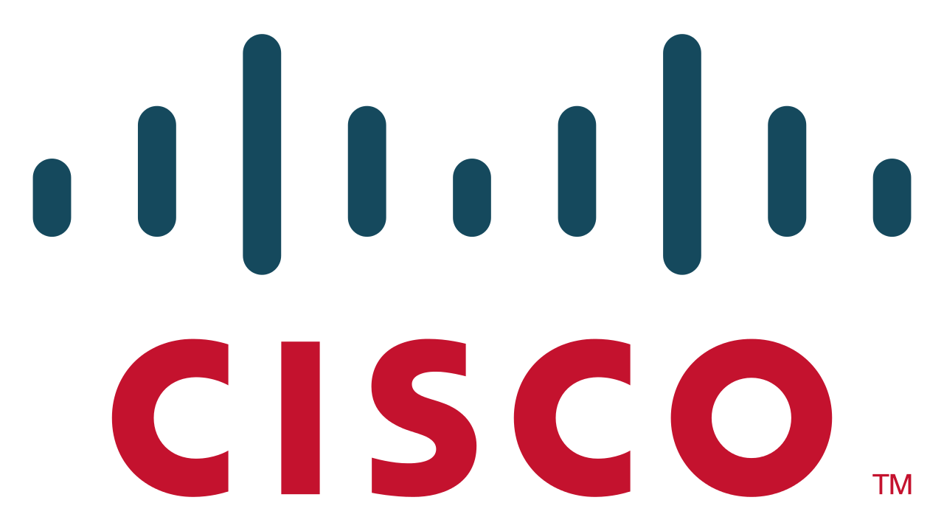
Hello World
Who am I?
Security Researcher for Cisco

Slide 5
Hello World
Who am I?
Security Researcher for Cisco
Slightly paranoid

Slide 6
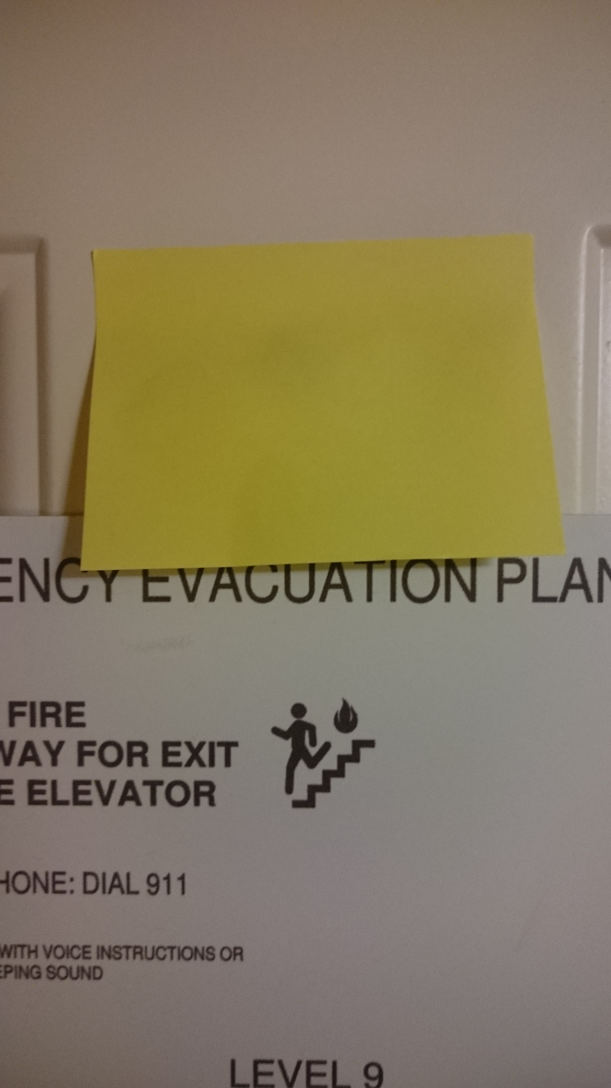
Hello World
Who am I?
Security Researcher for Cisco
Slightly paranoid

Slide 7
Hello World
Who am I?
Security Researcher for Cisco
Slightly paranoid
A new-ish puppy owner

Slide 8
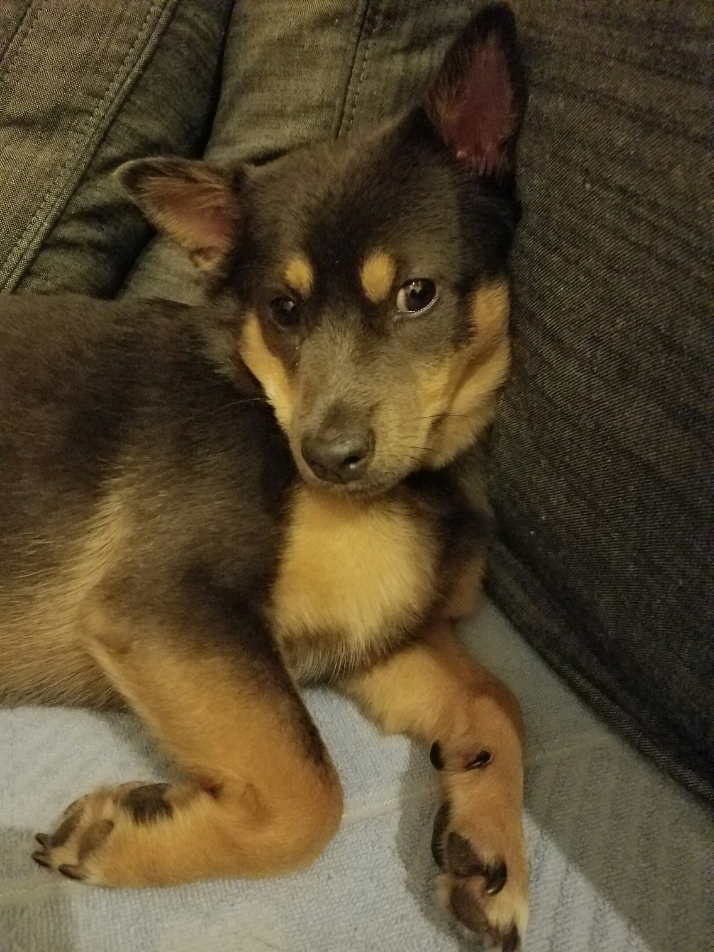
Hello World
Who am I?
Security Researcher for Cisco
Slightly paranoid
A new-ish puppy owner

Slide 9
Hello World
Who am I?
Security Researcher for Cisco
Slightly paranoid
A new-ish puppy owner
Human

Slide 10

Hello World
Who am I?
Security Researcher for Cisco
Slightly paranoid
A new-ish puppy owner
Human

Slide 11
What have I done?
Read a lot of whitepapers, news articles
Fiddled with a bunch of password managers
OSX 10.10-10.11 (Yosemite, El Capitan)
Windows 8 (Ugh…)
Ubuntu 12.X (Precise Pangolin)
Android 4.2 (Jelly Bean)

Slide 12
Why?
Because paranoid people like to have long, complex, unique passwords for each login
And, because PC Magazine’s table is not helpful to me.

Slide 13
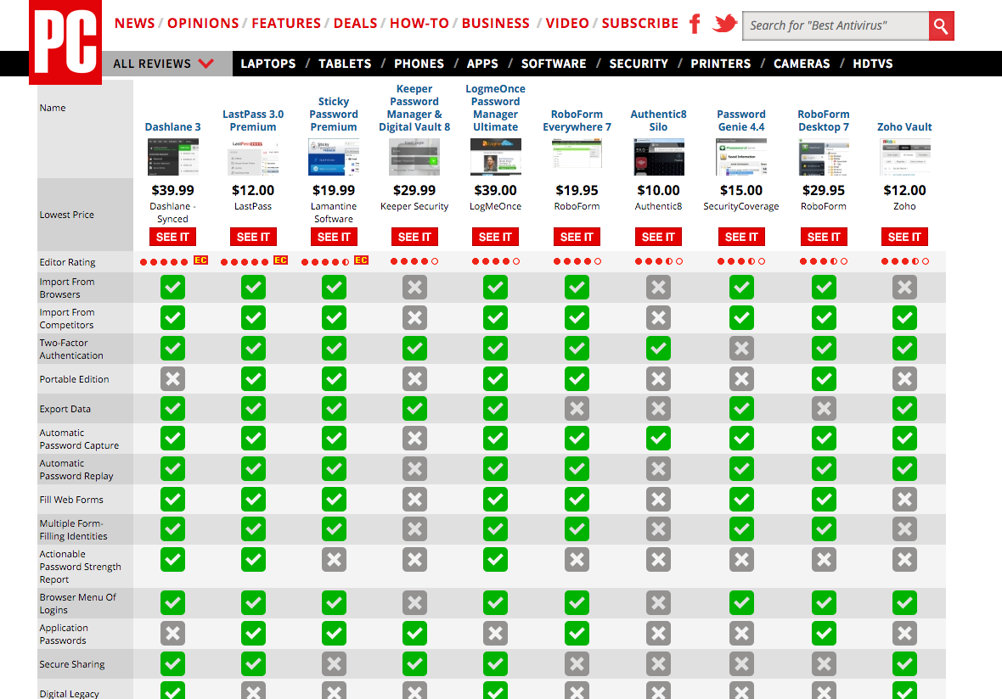
Why?

Slide 14
Why?
WHAT?

Slide 15

Who did I choose?
PC Magazine’s #1 pick
6th hit when Googling for “password manager”

Slide 16
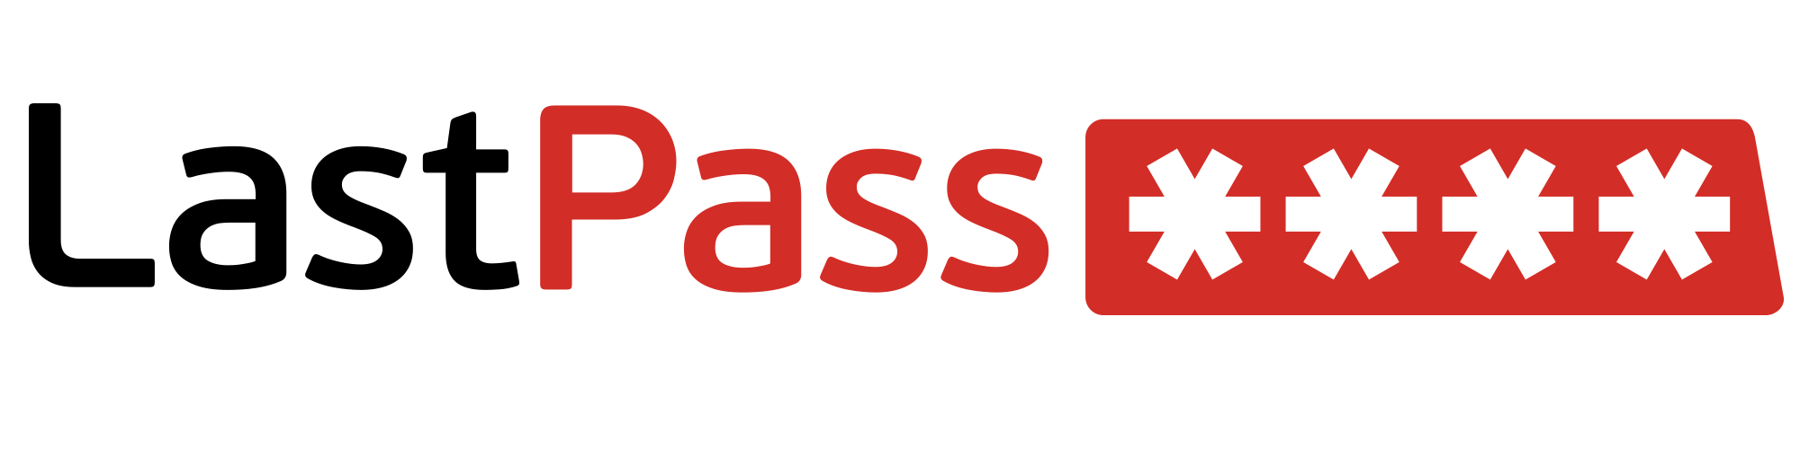
Who did I choose?
Informal survey of my co-workers (ISomC) shows they like this one
3rd hit when Googling for “password manager”

Slide 17

Who did I choose?
ISomC revealed Keepass is a popular open-source choice
7th hit when Googling for “password manager”

Slide 18
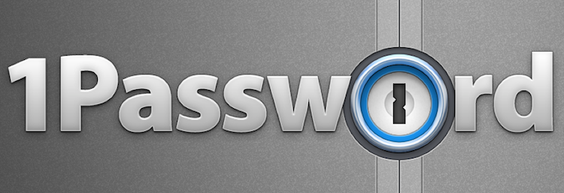
Who did I choose?
ISomC reveals they like this too

Slide 19

Who did I choose?
Installed by default on some AT&T phones

Slide 20

Who did I choose?
Purchased by Intel
Legacy Locker

Slide 21
Who did I choose?
Purchased by Intel
Legacy Locker

Slide 22
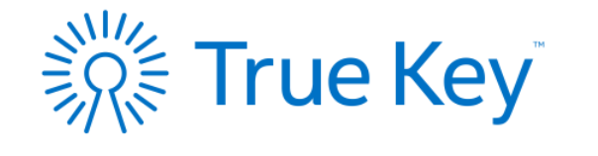
Who did I choose?
Purchased by Intel
Legacy Locker
EOL’ed
Nov ’15
Replaced w/ Intel’s

Slide 23

Footnote
Roboform came up a lot during research, but I did not get to it.
Pick one that works for YOU.
Spoiler: cost, extra features usually distinguish
There are so many more out there, but popular ones are more likely to be updated and/or supported in the future.

Slide 24
The Basics: Desktop Platforms
OSX Windows Linux | IE Safari Chrome Firefox Opera | OSX Windows Linux
OSX Windows Linux | OSX Windows Linux | OSX Windows
Notes:
1password anywhere, a web interface through Dropbox is supported on Linux, but it’s hardly the feature rich platform available elsewhere.
Lastpass and Password Box are browser only

Slide 25
The Basics: Mobile Platforms
iOS Android Windows | iOS Android Windows +++ | iOS Android Windows ++ (contributed)
iOS Android Windows | iOS Android Windows +++ | iOS Android Windows
Notes:
Just because Keepass’ ports to mobile are unofficial and/or contributed by the community, doesn’t mean they’re not good. Crowd contributions is how open source exists. Keepass ports include blackberry and even palm OS. Lastpass has some limited or paid versions for HP webOS (palm OS), blackberry.
Keeper has several tablet apps as well – surface, kindle fire, nook.

Slide 26
The Basics: Encryption
the strongest encryption in the industry | accepted by the US Government for protecting top secret data | is approved by the National Security Agency (NSA) for top secret information
military grade encryption | is sufficiently secure to encrypt classified data up to TOP SECRET classification for the U.S. Government | the strongest encryption available

Slide 27
The Basics: Encryption
AES-256 | AES-256 | AES-256
AES-256 | AES-256 | AES-256

Slide 28
The Basics: Password Hashing
PBKDF2- HMAC-SHA1 10,000 iterations | PBKDF2- HMAC-SHA256 5,000 minimum configurable | SHA-256 6,000 iterations configurable
PBKDF2- HMAC-SHA512 10,000 minimum | PBKDF2- HMAC-SHA256 1,000 minimum | PBKDF2- HMAC-SHA512 ??? iterations

Slide 29
Master Passwords
Sentences and numbers YOU know
“I lived on 512 Garfield street from first to eighth grade”
ILO%!@Gstf1st**8thGR@DE
23 characters, 8 uppercase, 7 lowercase, 6 symbols, 2 numbers
KEEP TYPING IT
zxcvbn by Dropbox to check*
*TrueKey say they use zxcvbn

Slide 30
The Basics: Cost for Syncing
Free for 1 device $40/year | Free for Desktops $12/year | Free (open-source)
Free for 1 mobile dev $50-70/license | Free for 1 mobile dev $30/year | Free for 15 passwords $20/year

Slide 31
The Basics: Ways to Sync
Amazon Web Services | “Lastpass servers” | Dropbox
iCloud Dropbox Local Wi-Fi | Amazon Web Services | “True Key servers”

Slide 32
Two-factor Authentication
Authy, Google, FreeOTP | Authy, Google, Yubikey, RSA SecurID, +++++ | Key file
None *Is TOTP | Phone, Keeper DNA, RSA SecurID, Google | Biometrics?! Second Device
Notes:
TOTP= time based one time password

Slide 33
Transparency (1 is least, 3 is most)
Detailed white paper (2) | Detailed help desk (2) | Open Source (3)
Detailed file structure (2) | Brief security page (1) | Brief white paper (1)

Slide 34
Fun Stuff!
Shoutout to Lorrie Cranor
has an amazing TED talk about passwords
has an amazing “bad password” dress
had an amazing password research group at Carnegie Mellon…as of Jan 2016 is now the CTO of the FTC!
gave a great presentation last year at GHC that got me thinking

Slide 35
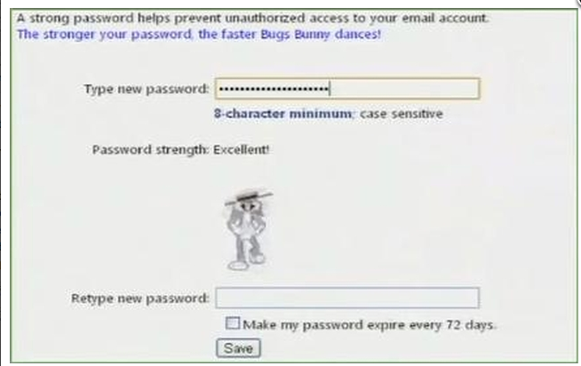
Password Meters

Slide 36
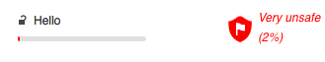
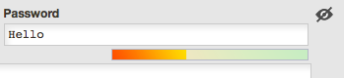
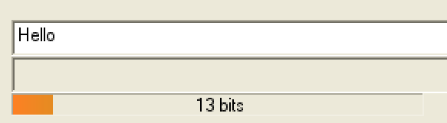
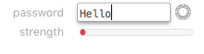
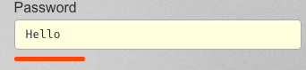
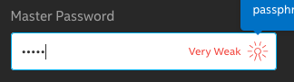
Hello

Slide 37
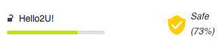
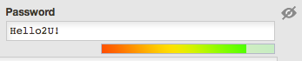
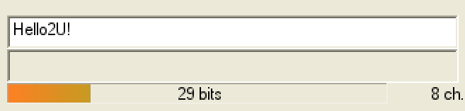
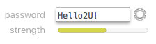
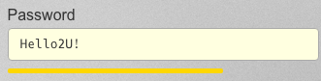
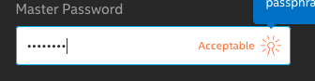
Hello2U!

Slide 38
Hello2U!

Slide 39
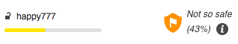
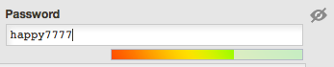
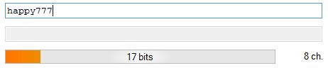
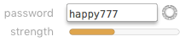
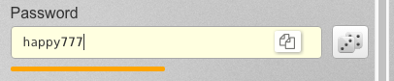
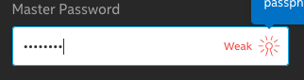
happy777

Slide 40
happy777

Slide 41
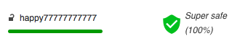
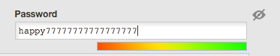
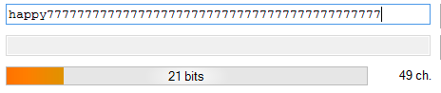
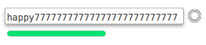
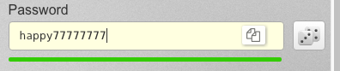
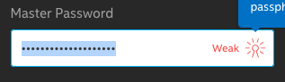
happy777777777777777777

Slide 42
happy777777777777777777

Slide 43
happy777777777777777777

Slide 44
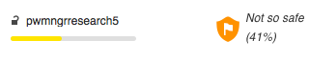
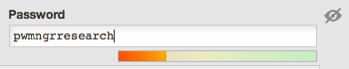
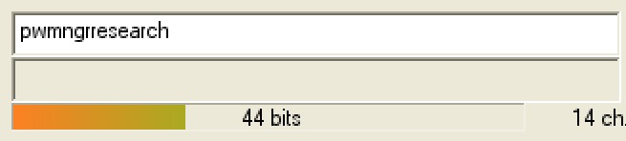
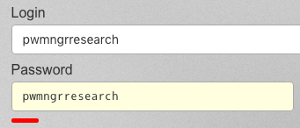
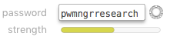
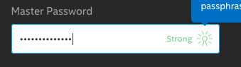
Username match?

Slide 45
Username match?

Slide 46
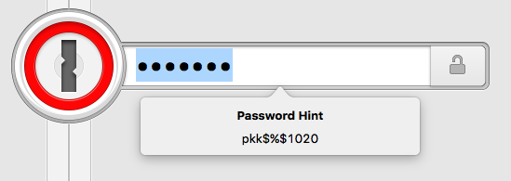
Last minute thoughts!
No one can help you recover your password
But 1Password lets you have a hint!

Slide 47
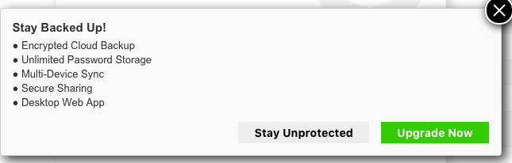
Last minute thoughts!
Keeper pressures you to buy!
I’m not unprotected! I’m cheap!

Slide 48
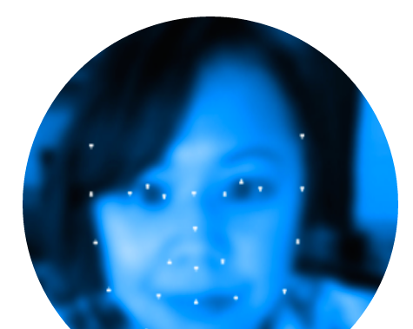
Last minute thoughts!
REQUIRES browser plug-in ☹
2+ factor authentication includes biometrics: face and fingerprint
Face was fairly unreliable, but I’ll never use biometrics anyway!
Notes:
https://www.wired.com/2008/03/hackers-publish/
https://www.schneier.com/blog/archives/2015/10/stealing_finger.html

Slide 49
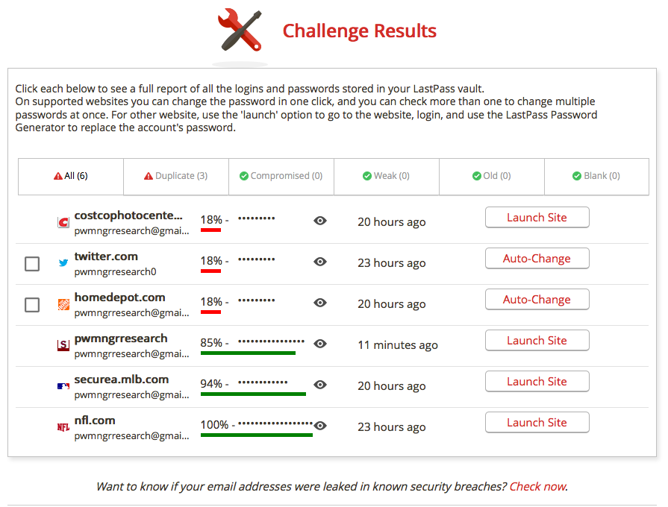
Last minute thoughts!
Report cards!

Slide 50
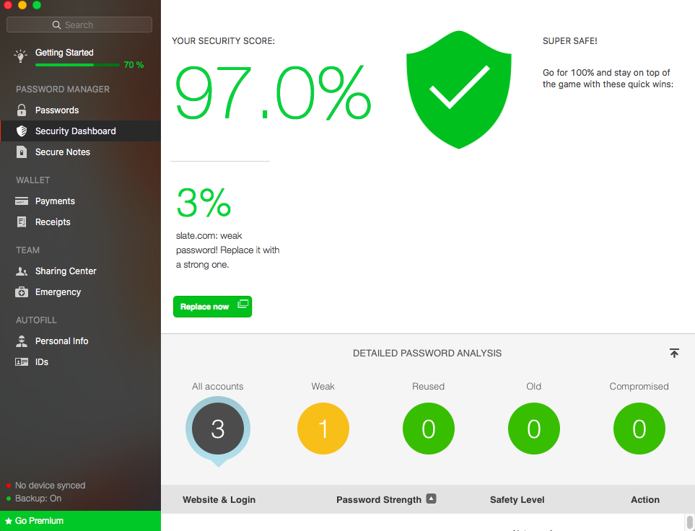
Last minute thoughts!
Report cards

Slide 51
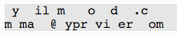
Last minute thoughts!
Keepass: Two-channel auto-type obfuscation
mymail@provider.com gets split:
Made the news June 2016 – auto check for
updates was done over HTTP w/ no
signing; for ad revenue.
Notes:
http://lifehacker.com/keepass-vulnerability-could-let-attackers-steal-your-pa-1781486764
http://themerkle.com/keepass-developer-prefers-money-over-security/
Pressured into HTTPS AND digital signing of images
http://keepass.info/help/kb/sec_issues.html#updsig

Slide 52
Thanks!
jekam@cisco.com
@txjenniek
github.com/txjenniek
Form Filling
Password generation (pronounceable, entropy?)
Sharing passwords
Storing files
Auto-change of passwords
Permissions requested of browsers, mobile

